Slide 1
DIGITAL ELECTRONICS • SIGNED INTEGERS • LOGIC GATES • SIMULATION
Presentation Deck
Design & Simulation of an 8-Bit Signed Binary Representation System
Modeling signed integer conversion using the Sign-Magnitude Method and verifying logic subsystem performance.
SPECIFICATION
CH SHARON KUMAR2620030035
K AKSHITH REDDY2620030202
D GURU VARDHAN2620030514
SYED IRFAN2620030054
1 Sign Bit + 7 Magnitude Bits | Range: −127 to +127

Slide 2



01. Introduction
Project Overview & Specifications
Signed Binary Representation
Sign-Magnitude Standard
Simulation & Validation
Essential for digital systems to differentiate positive and negative numerical quantities accurately.
The most significant bit (MSB) indicates polarity, while remaining bits store absolute magnitude.
Fully modeled using logic gate subsystems for functional encoding and visual verification.
Slide 2

Slide 3
02. Problem Statement
The Challenge in Digital Computing
Core Problem
Input Stage
Signed Decimal Integer
Digital circuits naturally operate on unsigned binary signals. Implementing negative integers requires a dedicated architectural method to encode sign metadata alongside numerical magnitude without loss of precision.
Processing
8-Bit Sign-Magnitude
Goal: Establish a robust encoding scheme using logic gates to separate and process polarity indicators.
Output Stage
Validated Output Display
Slide 3

Slide 4
03. Objectives
Key Goals of the Design
01
Represent
02
Encode
Represent signed integers cleanly in an 8-bit sign-magnitude binary format.
Isolate and split the MSB sign indicator from the seven numerical magnitude bits.
03
Decode
04
Simulate & Validate
Accurately recover the signed integer value from its stored binary representation.
Build the system architecture using digital logic subsystems and verify visual display.
Slide 4

Slide 5
04. Architecture Specification
8-Bit Sign-Magnitude Structure
BIT ALLOCATION MAP
Bit 7 (MSB)
Sign Bit: 0=(+), 1=(−)
Bit 6
Bit 5
Bit 4
Bit 3
Bit 2
Bit 1
Bit 0
Absolute Numerical Magnitude (0 to 127)
Positive Example (+90)
Negative Example (−90)
0 1011010
1 1011010
MSB = 0 | Magnitude = 90
MSB = 1 | Magnitude = 90
Slide 5

Slide 6
05. Working Principle
Encoding & Decoding Logic
Subsystem Decoding
Positive vs. Negative Encoding
The system decoder routes Bit 7 directly to a sign indicator LED while feeding Bits 0–6 to magnitude numerical display drivers.
The 7-bit magnitude field remains completely identical between +N and −N. Only the single MSB sign bit flips state.
+5 Decimal 0 0000101
−5 Decimal 1 0000101
Direct bus separation enables immediate parallel processing of sign metadata and numeric data.
Slide 6

Slide 7



06. System Architecture
High-Level Hardware Pipeline
Signed Input
Splitter Unit
Logic Subsystem
Display Output
Decimal value entry point
Separates MSB & magnitude
Processes gate paths
Visual signal verification
Slide 7

Slide 8

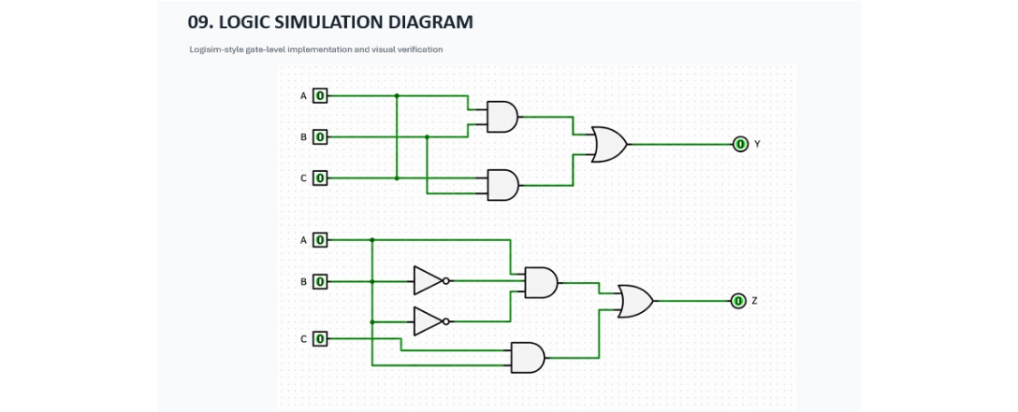
07. LOGIC SIMULATION DIAGRAM
Logisim Gate-Level Circuit Implementation
Slide 8

Slide 9
08. LOGIC GATES TRUTH TABLE
Combinational Circuit Truth Table (Outputs Y & Z)
Input A | Input B | Input C | Output Y = (A · B) + (B · C) | Output Z = (A · B' · C') + (A · C)
0 | 0 | 0 | 0 | 0
0 | 0 | 1 | 0 | 0
0 | 1 | 0 | 0 | 0
0 | 1 | 1 | 1 | 0
1 | 0 | 0 | 0 | 1
1 | 0 | 1 | 0 | 1
1 | 1 | 0 | 1 | 0
1 | 1 | 1 | 1 | 1
Slide 9

Slide 10
09. Critical Analysis
Limitations of Sign-Magnitude
Dual Representation of Zero
Arithmetic Hardware Complexity
Creates redundant binary representation states, wasting computational state space.
Addition and subtraction require comparing sign bits before processing, leading to additional logic gate overhead.
+0 Positive Zero 0 0000000
−0 Negative Zero 1 0000000
Impact: Increased circuit propagation delay and higher gate count for ALU design.
Slide 10

Slide 11
10. KEY TAKEAWAYS
Results & Verification
100%
±127
Realtime
Modular
Accurate Processing
Full Dynamic Range
Visual Output
Logic Design
Validated sign-magnitude conversion.
Supports integers from −127 to +127.
Immediate display response in simulation.
Clean subsystem design architecture.
THANK YOU
Slide 11

